Slide 1
Choosing Interaction Elements: Software Components Lecture 6

Slide 2
Introduction
We concentrate on the following software components:
Text. How can we ensure that the text is legible? Which font should we use?
Color. Which colors go well together? How should color be used to communicate information more effectively? How can we ensure that the colors we use have the correct connotations?
Images. What are the different types of images? How do you choose the right one?
Moving images. When is it useful to animate images?
Sound. When can sound be useful? What are the different categories of sound and when should each be used?

Slide 3
Text
It is a flexible and powerful means of communication.
Text has a number of technical advantages:
Text files are small. Images, sound, animation, and video all produce large computer files, even when compressed. These files can be slow to load from CD-ROM or to transmit via the Internet; this can reduce the usability of the UI.
Text can be manipulated very easily. For example, it is possible to search for words.
Text is less ambiguous.

Slide 4
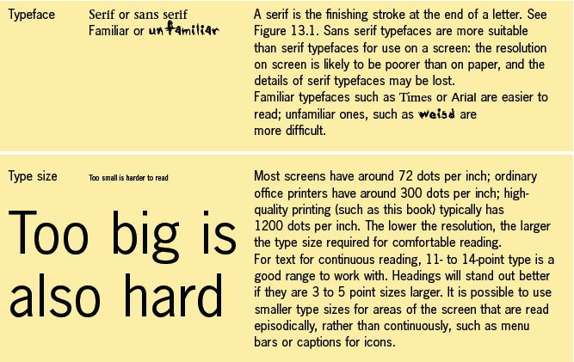
Text Is Legible

Slide 5
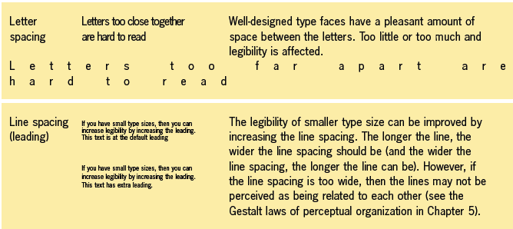
Text Is Legible

Slide 6
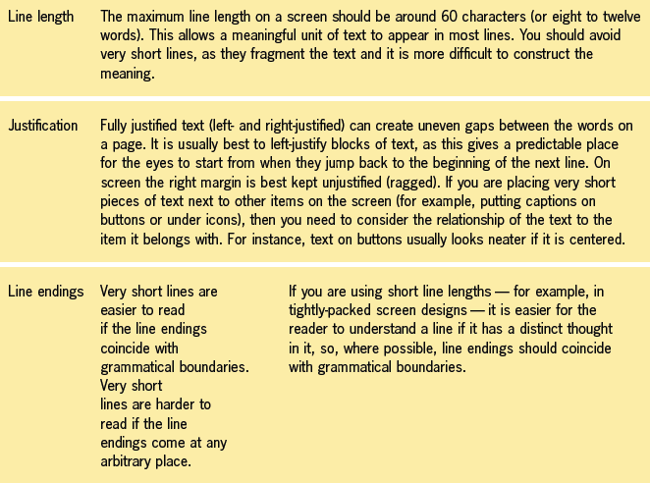
Text Is Legible

Slide 7
Color
We can use color for a variety of reasons:
To draw attention.
To show status. As the status becomes more critical, the color might change. An example of this is a traffic light changing from yellow to red.
To make the information on the display clearer.
To make the display more attractive.

Slide 8

Characteristics of Color
There are also differences in the way we perceive color from a screen compared to the way we perceive color from paper. This means that the screen versions of colors can appear pale and unreal when compared with the equivalent paper versions. It also increases the likelihood of flickering for color combinations such as red and blue, as shown in the following Figure.

Slide 9
Choosing Colors with Right Connotations
When you use a color, you should think about what it is likely to mean to the people who look at it, as colors can have different connotations. These connotations are partly cultural.
The color saturation can also be significant. Colors aimed at young people tend to be pure and bright, whereas colors aimed at older people are deeper
Make sure that you apply the colors consistently.

Slide 10
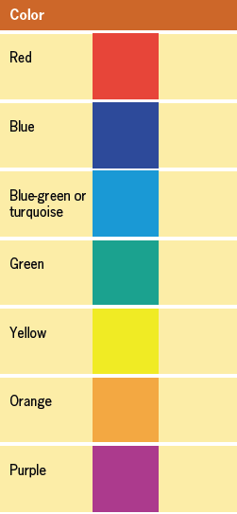
EXERCISE
Look at the color chips in this Figure for a moment, and then write down a positive connotation and a negative connotation for each one.
Reactions to colors are:
Partly personal, due to associations that we have each created from childhood.
Partly cultural, due to the way that colors are used in our surroundings.
Partly contextual, inherited from the way the color is used in a specific object.

Slide 11
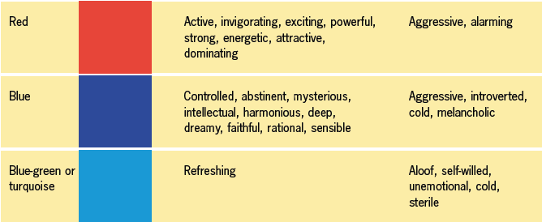
Connotations of Different Colors

Slide 12
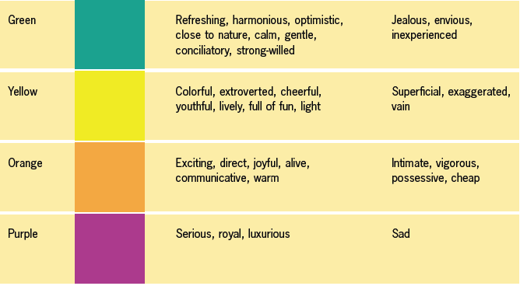
Connotations of Different Colors

Slide 13
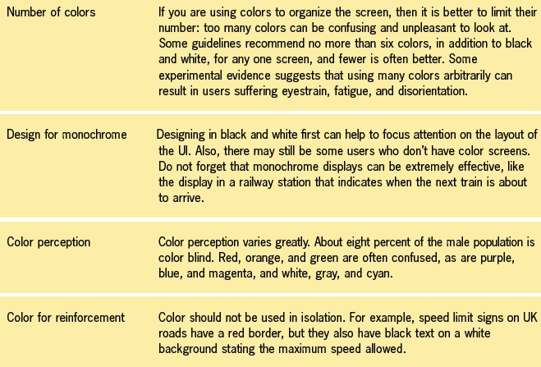
How to Use Color Effectively

Slide 14
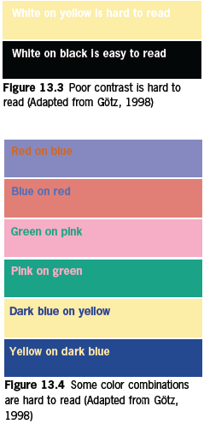
How to Use Color Effectively
An important factor when you use several colors is the intrinsic brightness of each, such that:
For legible text, there needs to be sufficient contrast between the brightness of the background and foreground colors.
You should be careful when using bright colors, such as white or bright yellow, for large areas of the screen
Contrasts in the brightness should not be too extreme, as this may lead to a blurring.

Slide 15
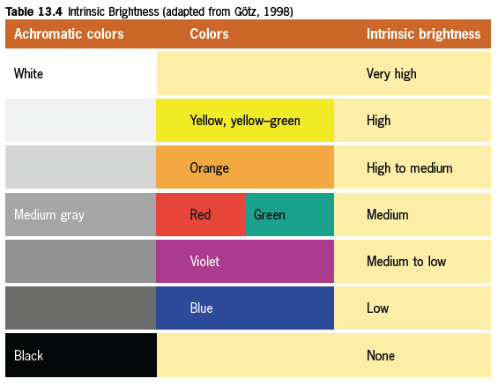
Intrinsic brightness

Slide 16
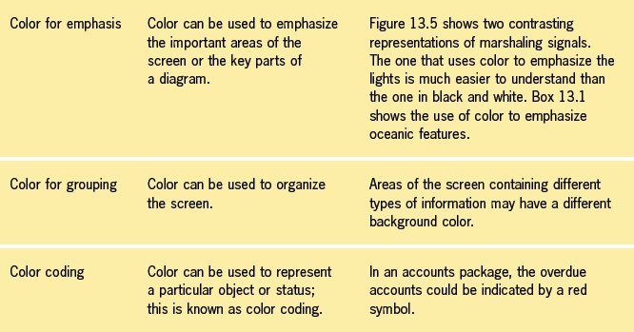
Color to Represent Information

Slide 17
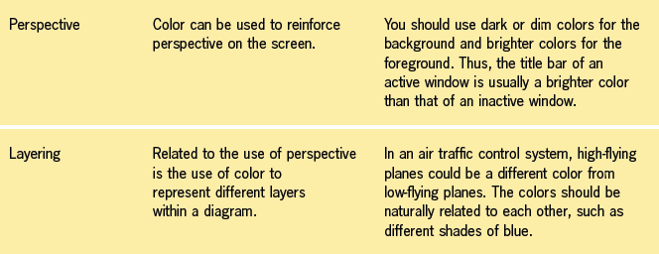
Color to Represent Information

Slide 18
Images
We can use images in several ways:
To motivate to attract the attention of the user, to amuse, and to persuade. These uses are particularly important in advertising and marketing.
To communicate information, especially spatial information.
To help overcome language barriers. This approach is widely used in instruction manuals for consumer items.
To support interaction. Examples include screen metaphors and icons.

Slide 19
Using Images Effectively
The following are the main types of images:
Pictures. These include photographs, drawings, and cartoons.
Diagrams. These include maps and other representations of relationships between objects, such as family trees and Venn diagrams.
Graphs and charts. These are visual representations of numbers. Thus, they include pie charts, histograms, line charts, and bar charts.

Slide 20
Using Images Effectively
When you are considering using an image, you should remember the following points:
Choose the most appropriate type of image (picture, diagram, or graph/chart), according to the information you need.
Design the image so that it meets the requirements of the task as closely as possible.
Follow any relevant conventions, Combining text and images can be particularly effective.
Take the user’s screen resolution into account.

Slide 21
Moving Images
At present, most moving images are used in an unsophisticated way that requires little interaction from the user. Some people with disabilities find moving images problematic.
You can use animation for the following purposes:
To illustrate movement.
To provide dynamic feedback.
To attract attention.
To show that the computer system is operating.

Slide 22
Using Video Clips Effectively
However, video has the following additional uses:
To convey human behavior and emotions.
To show events that users cannot see directly.
To motivate.
To provide additional contextual information.

Slide 23
Sound
Sound is especially useful as an output when people cannot easily see a visual prompt, such as:
Applications where the eyes and attention are required to be away from the screen.
Applications involving process control.
Applications addressing the needs of visually impaired users.
Different Types of Sound:
Sounds come in these categories:
Ambient sounds and sound effects
Music
Speech

Slide 24
Good Use of Sound Effects
Sound effects can communicate information in a variety of ways. In particular, they can do the following:
Reinforce the visual component of the UI.
Confirm the successful completion of an operation.
Attract attention.
Problems with the Use of Sound
Sound has the potential to intrude on the environment
Sound is not good at conveying detailed information

Slide 25
THANKS

